Slide 1

MACHINE INTELLIGENCE
Dr. N MEHALA
Department of Computer Science and Engineering

Slide 2

MACHINE INTELLIGENCE
Module 4 [Unsupervised Learning]
Dr. N MEHALA
Department of Computer Science and Engineering

Slide 3
MACHINE INTELLIGENCE
Supervised Vs Unsupervised Learning

Slide 4
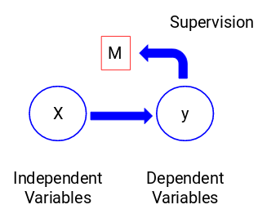
MACHINE INTELLIGENCE
Supervised Learning
We train our model using the independent variables in the supervision of the target variable and hence the name supervised learning.

Slide 5
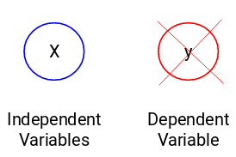
MACHINE INTELLIGENCE
Unsupervised Learning
There might be situations when we do not have any target variable to predict.
Such problems, without any explicit target variable, are known as unsupervised learning problems.
We only have the independent variables and no target/dependent variable in these problems.

Slide 6
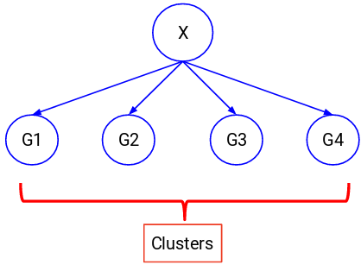
MACHINE INTELLIGENCE
UnSupervised Learning
Divide the entire data (X) into a set of groups. These groups are known as clusters and the process of making these clusters is known as clustering.

Slide 7
MACHINE INTELLIGENCE
Supervised Vs Unsupervised Learning
Why Supervised Learning?
Supervised learning allows you to collect data or produce a data output from the previous experience.
Helps you to optimize performance criteria using experience
Supervised machine learning helps you to solve various types of real-world computation problems.

Slide 8
MACHINE INTELLIGENCE
Supervised Vs Unsupervised Learning

Slide 9
MACHINE INTELLIGENCE
Clustering
Finding groups of objects such that the objects in a group will be similar (or related) to one another and different from (or unrelated to) the objects in other groups
Inter-cluster distances are maximized
Intra-cluster distances are minimized

Slide 10
MACHINE INTELLIGENCE
Clustering: Example Applications
Marketing
Insurance
City-planning
Earth-quake studies

Slide 11
MACHINE INTELLIGENCE
Clustering: Approaches
Clustering
Hierarchical
Partitional
Density
based
Grid-based

Slide 12
MACHINE INTELLIGENCE
Partitional Clustering
Original Points
A Partitional Clustering

Slide 13
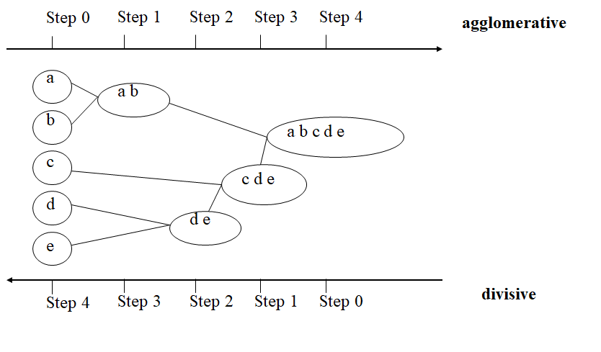
MACHINE INTELLIGENCE
Hierarchical Clustering

Slide 14
MACHINE INTELLIGENCE
Hierarchical Clustering
Traditional Hierarchical Clustering
Traditional Dendrogram
Non-traditional Hierarchical Clustering
Non-traditional Dendrogram

Slide 15
MACHINE INTELLIGENCE
Hierarchical Clustering
Produces a set of nested clusters organized as a hierarchical tree
Can be visualized as a dendrogram
A tree like diagram that records the sequences of merges or splits

Slide 16
MACHINE INTELLIGENCE
Hierarchical Clustering: Strength
Do not have to assume any particular number of clusters
Any desired number of clusters can be obtained by ‘cutting’ the dendrogram at the proper level

Slide 17
MACHINE INTELLIGENCE
Agglomerative Hierarchical Clustering
Popular hierarchical clustering technique
Basic algorithm is straightforward
Compute the proximity matrix
Let each data point be a cluster
Repeat
Merge the two closest clusters
Update the proximity matrix
Until only a single cluster remains
Key operation is the computation of the proximity of two clusters
Different approaches to defining the distance between clusters distinguish the different algorithms

Slide 18
MACHINE INTELLIGENCE
Agglomerative Hierarchical Clustering
Start with clusters of individual points and a proximity matrix
p1
p2
p3
p4
p5
. . .
p1
p2
p3
p4
p5
.
.
.
Proximity Matrix

Slide 19
MACHINE INTELLIGENCE
Intermediate Situation
After some merging steps, we have some clusters
C1
C2
C3
C4
C5
C1
C2
C3
C3
C4
C4
C5
Proximity Matrix
C1
C2
C5

Slide 20
MACHINE INTELLIGENCE
Intermediate Situation
We want to merge the two closest clusters (C2 and C5) and update the proximity matrix.
C1
C2
C3
C4
C5
C1
C2
C3
C4
C3
C5
C4
Proximity Matrix
C1
C2
C5

Slide 21
MACHINE INTELLIGENCE
Intermediate Situation: After Merging
The question is “How do we update the proximity matrix?”
C1
C3
C4
C2 U C5
C1
?
C2 U C5
? ? ? ?
C3
C3
?
C4
C4
?
Proximity Matrix
C1
C2 U C5

Slide 22
MACHINE INTELLIGENCE
Inter-Cluster Similarity: Methods
p1
p2
p3
p4
p5
. . .
Similarity?
p1
p2
p3
p4
p5
MIN
MAX
Group Average
Distance Between Centroids
Other methods driven by an objective function
Ward’s Method uses squared error
.
.
.
Proximity Matrix

Slide 23
MACHINE INTELLIGENCE
Inter-Cluster Similarity: Methods
p1
p2
p3
p4
p5
. . .
p1
p2
p3
p4
p5
MIN
MAX
Group Average
Distance Between Centroids
Other methods driven by an objective function
Ward’s Method uses squared error
.
.
.
Proximity Matrix

Slide 24
MACHINE INTELLIGENCE
Inter-Cluster Similarity: Methods
p1
p2
p3
p4
p5
. . .
p1
p2
p3
p4
p5
MIN
MAX
Group Average
Distance Between Centroids
Other methods driven by an objective function
Ward’s Method uses squared error
.
.
.
Proximity Matrix

Slide 25
MACHINE INTELLIGENCE
Inter-Cluster Similarity: Methods
p1
p2
p3
p4
p5
. . .
p1
p2
p3
p4
p5
.
.
.
Proximity Matrix
MIN
MAX
Group Average
Distance Between Centroids
Other methods driven by an objective function
Ward’s Method uses squared error

Slide 26
MACHINE INTELLIGENCE
Inter-Cluster Similarity: Methods
p1
p2
p3
p4
p5
. . .
p1
×
×
p2
p3
p4
p5
MIN
MAX
Group Average
Distance Between Centroids
Other methods driven by an objective function
.
.
.
Proximity Matrix

Slide 27
MACHINE INTELLIGENCE
Inter-Cluster Similarity: Methods (Example)
assume that there are two clusters: C1: {a, b} and C2: {c, d, e}.
1. Calculate the distance matrix . 2. Calculate three cluster distances between C1 and C2.
 | a | b | c | d | e
Feature | 1 | 2 | 4 | 5 | 6
Single link
Complete link
Average
 | a | b | c | d | e
a | 0 | 1 | 3 | 4 | 5
b | 1 | 0 | 2 | 3 | 4
c | 3 | 2 | 0 | 1 | 2
d | 4 | 3 | 1 | 0 | 1
e | 5 | 4 | 2 | 1 | 0

Slide 28
MACHINE INTELLIGENCE
Dr. N MEHALA
Department of Computer Science and Engineering

Slide 29
MACHINE INTELLIGENCE
Module 4 [Unsupervised Learning]
Dr. N MEHALA
Department of Computer Science and Engineering

Slide 30
MACHINE INTELLIGENCE
Example1: Hierarchical Clustering

Slide 31
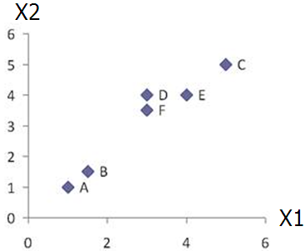
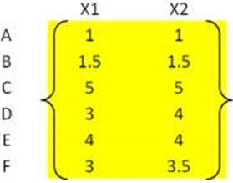
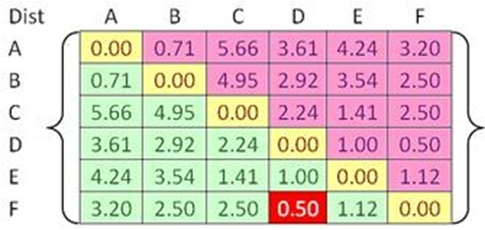


MACHINE INTELLIGENCE
Example1: Hierarchical Clustering
Problem: clustering analysis with agglomerative algorithm
data matrix
distance matrix
Euclidean distance

Slide 32
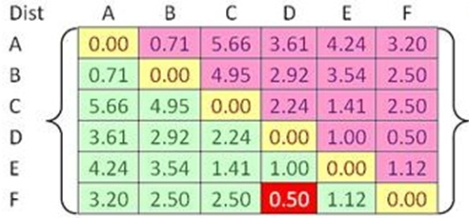
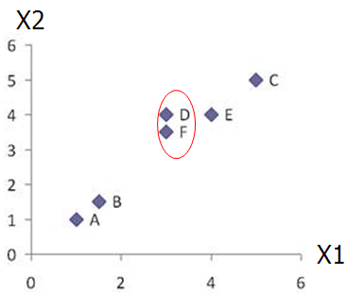
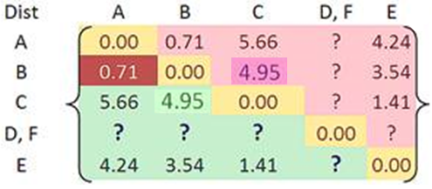

MACHINE INTELLIGENCE
Example1: Hierarchical Clustering
Merge two closest clusters (iteration 1)

Slide 33
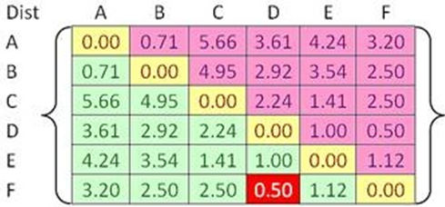

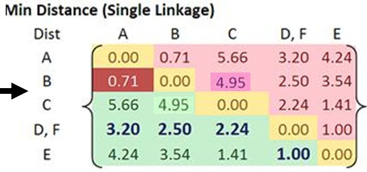
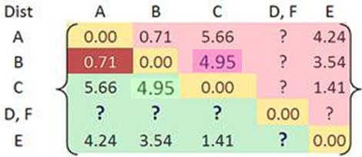
MACHINE INTELLIGENCE
Example1: Hierarchical Clustering
Update distance matrix (iteration 1)

Slide 34
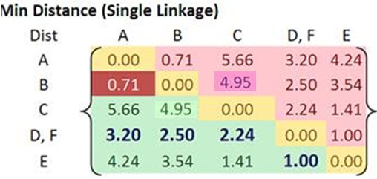
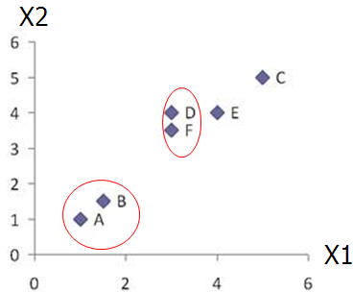
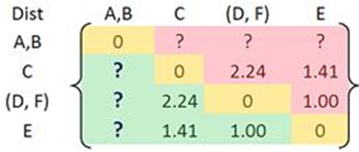
MACHINE INTELLIGENCE
Example1: Hierarchical Clustering
Merge two closest clusters (iteration 2)

Slide 35
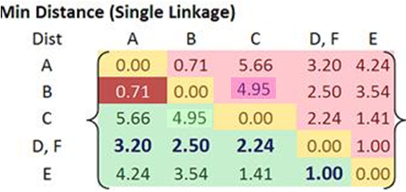
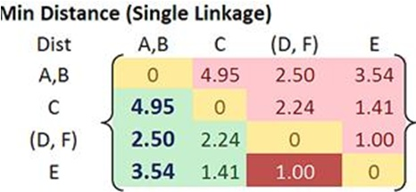

MACHINE INTELLIGENCE
Example1: Hierarchical Clustering
Update distance matrix (iteration 2)

Slide 36
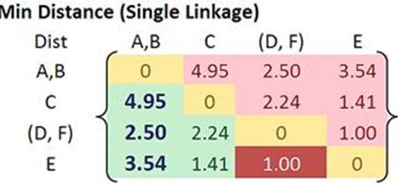
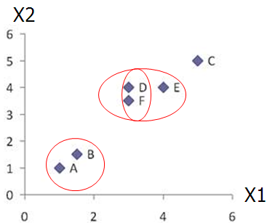
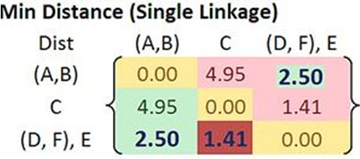

MACHINE INTELLIGENCE
Example1: Hierarchical Clustering
Merge two closest clusters/update distance matrix (iteration 3)

Slide 37
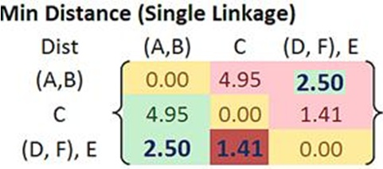
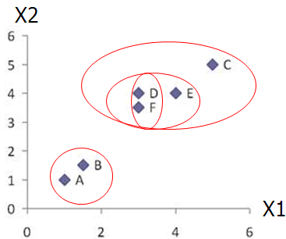
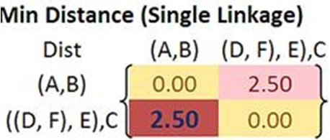

MACHINE INTELLIGENCE
Example1: Hierarchical Clustering
Merge two closest clusters/update distance matrix (iteration 4)

Slide 38
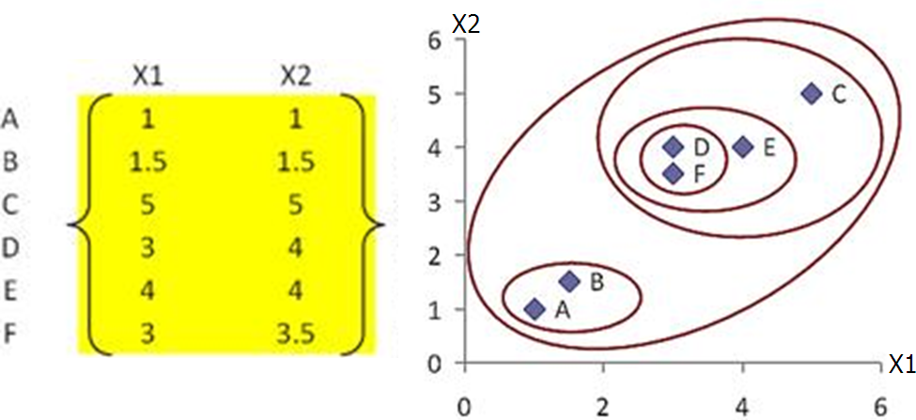
MACHINE INTELLIGENCE
Example1: Hierarchical Clustering
Final result (meeting termination condition)

Slide 39
MACHINE INTELLIGENCE
Example: Hierarchical Clustering
Assume that the database D is given by the table below. Follow single link (Min) technique to find clusters in D.
Note: Use Euclidean distance measure.
Students | X (Marks in Course1) | Y (Marks in Course2)
p1 | 0.40 | 0.53
p2 | 0.22 | 0.38
p3 | 0.35 | 0.32
p4 | 0.26 | 0.19
p5 | 0.08 | 0.41
p6 | 0.45 | 0.30

Slide 40
MACHINE INTELLIGENCE
Example: Hierarchical Clustering
Step 1. Assume all the objects p1, p2, … p6 in a separate Clusters

Slide 41
MACHINE INTELLIGENCE
Example: Hierarchical Clustering
Step 2. Calculate the Proximity matrix.
Euclidean distance between points i and j :
d(i, j) = (|x_{i1} - x_{j1} |²+ | x_{i2} – x_{j2}|² + … + | x_{ip} - x_{jp}|²)^{0.5}
where x_{i1} is the value of attribute 1 for i
and x_{j1} is the value of attribute 1 for j, and so on.
Euclidean distance between our points p1 and p2, which have attributes x and y would be calculated as follows:
d(p1, p2) = sqrt( |x_{p1} – x_{p2} |²+ | y_{p1} - y_{p2}|² )
= sqrt(|0.40 – 0.22 |²+ | 0.53 – 0.38|² )
= sqrt( |0.18 |²+ | 0.15|²) = sqrt( 0.0324 + 0.0225 )= sqrt( 0.0549)
= 0.2343
Students | X (Marks in Course1) | Y (Marks in Course2)
p1 | 0.40 | 0.53
p2 | 0.22 | 0.38
p3 | 0.35 | 0.32
p4 | 0.26 | 0.19
p5 | 0.08 | 0.41
p6 | 0.45 | 0.30

Slide 42
MACHINE INTELLIGENCE
Example: Hierarchical Clustering
Distance matrix
p1 | 0
p2 | 0.24 | 0
p3 | 0.22 | 0.15 | 0
p4 | 0.37 | 0.20 | 0.15 | 0
p5 | 0.34 | 0.14 | 0.28 | 0.29 | 0
p6 | 0.23 | 0.25 | 0.11 | 0.22 | 0.39 | 0
 | p1 | p2 | p3 | p4 | p5 | p6

Slide 43
MACHINE INTELLIGENCE
Example: Hierarchical Clustering
Step 3: Identify the two clusters with the shortest distance in the matrix, and merge them together. Re-compute the distance matrix, as those two clusters are now in a single cluster, (no longer exist by themselves).
By looking at the distance matrix above, we see that p3 and p6 have the smallest distance from all - 0.11 So, we merge those two in a single cluster, and re-compute the distance matrix.

Slide 44
MACHINE INTELLIGENCE
Example: Hierarchical Clustering
-0.30
-0.25
-0.20
-0.15
-0.10
-0.05
3
6

Slide 45
MACHINE INTELLIGENCE
Example: Hierarchical Clustering
Distance matrix
p1 | 0
p2 | 0.24 | 0
(p3, p6) | 0.22 | 0.15 | 0
p4 | 0.37 | 0.20 | 0.15 | 0
p5 | 0.34 | 0.14 | 0.28 | 0.29 | 0
 | p1 | p2 | (p3, p6) | p4 | p5

Slide 46
MACHINE INTELLIGENCE
Example: Hierarchical Clustering
Since, we have merged (p3, p6) together in a cluster, we now have one entry for (p3, p6) in the table, and no longer have p3 or p6 separately. Therefore, we need to re-compute the distance from each point to our new cluster - (p3, p6). We recall that, with the single link method the proximity of two clusters is defined as the minimum of the distance between any two points in the two clusters. Therefore, the distance between let’s say (p3, p6) and p1 would be calculated as follows:
dist( (p3, p6), p1 ) = MIN ( dist(p3, p1) , dist(p6, p1) )
= MIN ( 0.22 , 0.23 ) //from original matrix
= 0.22

Slide 47
MACHINE INTELLIGENCE
Example: Hierarchical Clustering
Step 4 Repeat Step 3 until all clusters are merged.
So, looking at the last distance matrix, we see that p2 and p5 have the smallest distance from all - 0.14 So, we merge those two in a single cluster, and re-compute the distance matrix.
p1 | 0
p2 | 0.24 | 0
(p3, p6) | 0.22 | 0.15 | 0
p4 | 0.37 | 0.20 | 0.15 | 0
p5 | 0.34 | 0.14 | 0.28 | 0.29 | 0
 | p1 | p2 | (p3, p6) | p4 | p5

Slide 48
MACHINE INTELLIGENCE
Example: Hierarchical Clustering
-0.30
-0.25
-0.20
-0.15
-0.10
-0.05
3
6
2
5

Slide 49
MACHINE INTELLIGENCE
Example: Hierarchical Clustering
Distance matrix
p1 | 0
(p2, p5) | 0.24 | 0
(p3, p6) | 0.22 | 0.15 | 0
p4 | 0.37 | 0.20 | 0.15 | 0
 | p1 | (p2, p5) | (p3, p6) | p4

Slide 50
MACHINE INTELLIGENCE
Example: Hierarchical Clustering
Since, we have merged (p2, p5) together in a cluster, we now have one entry for (p2, p5) in the table, and no longer have p2 or p5 separately. Therefore, we need to re-compute the distance from all other points / clusters to our new cluster - (p2, p5). The distance between (p3, p6) and (p2, p5) would be calculated as follows:
dist( (p3, p6), (p2, p5) ) = MIN ( dist(p3, p2) , dist(p6, p2), dist(p3, p5), dist(p6, p5) ) = MIN ( 0.15 , 0.25, 0.28, 0.39 ) //from original matrix = 0.15
Since we have more clusters to merge, we continue to repeat Step 3. So, looking at the last distance matrix above, we see that (p2, p5) and (p3, p6) have the smallest distance from all - 0.15 . We also notice that p4 and (p3, p6) have the same distance - 0.15 . In that case, we can pick either one. We choose (p2, p5) and (p3, p6). So, we merge those two in a single cluster, and re-compute the distance matrix.

Slide 51
MACHINE INTELLIGENCE
Example: Hierarchical Clustering
-0.30
-0.25
-0.20
-0.15
-0.10
-0.05
3
6
2
5

Slide 52
MACHINE INTELLIGENCE
Example: Hierarchical Clustering
Distance matrix
p1 | 0
(p2, p5, p3, p6) | 0.22 | 0
p4 | 0.37 | 0.15 | 0
 | p1 | (p2, p5, p3, p6) | p4
Since we have more clusters to merge, we continue to repeat Step 3.
So, looking at the last distance matrix above, we see that (p2, p5, p3, p6) and p4 have the smallest distance from all - 0.15 . So, we merge those two in a single cluster, and re-compute the distance matrix.

Slide 53
MACHINE INTELLIGENCE
Example: Hierarchical Clustering
Distance matrix
p1 | 0
(p2, p5, p3, p6, p4) | 0.22 | 0
 | p1 | (p2, p5, p3, p6, p4)
Since we have more clusters to merge, we continue to repeat Step 3.
So, looking at the last distance matrix above, we see that (p2, p5, p3, p6, p4) and p1 have the smallest distance - 0.22 (the only one left). So, we merge those two in a single cluster. There is no need to re-compute the distance matrix, as there are no more clusters to merge.

Slide 54
MACHINE INTELLIGENCE
Example: Hierarchical Clustering
-0.30
-0.25
-0.20
-0.15
-0.10
-0.05
3 6 2 5 4 1

Slide 55
MACHINE INTELLIGENCE
Hierarchical Clustering: Time and Space Requirement
O(N²) space since it uses the proximity matrix.
N is the number of points.
O(N³) time in many cases
There are N steps and at each step the size, N², proximity matrix must be updated and searched
Complexity can be reduced to O(N² log(N) ) time for some approaches

Slide 56
MACHINE INTELLIGENCE
Hierarchical Clustering: Limitations
Once a decision is made to combine two clusters, it cannot be undone
Different schemes have problems with one or more of the following:
Sensitivity to noise and outliers
Difficulty handling different sized clusters and convex shapes
Breaking large clusters

Slide 57
MACHINE INTELLIGENCE
Summary
Supervised Vs Unsupervised Learning
Clustering
Clustering Types
Partitional Vs Hierarchical Clustering
Agglomerative Vs Divisive Clustering
Agglomerative Hierarchical Clustering: Variants
Example: Agglomerative Hierarchical Clustering Variants

Slide 58
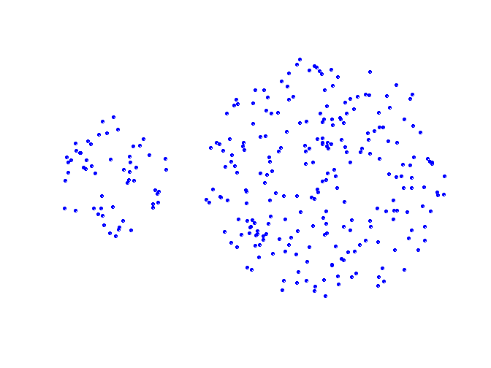
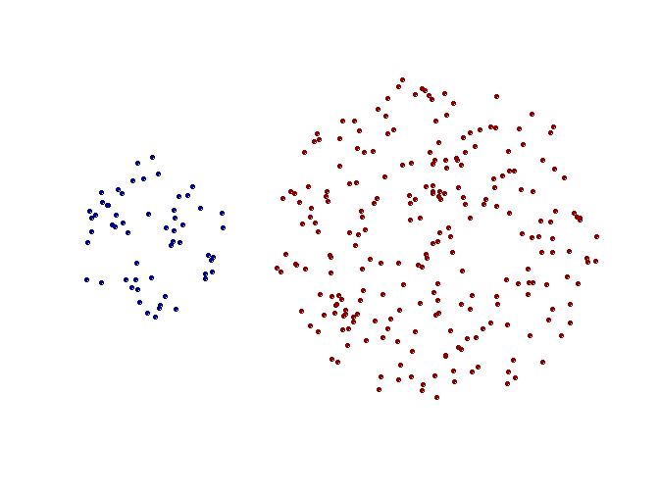
Strengths of single-link clustering
MACHINE INTELLIGENCE
Summary
Original Points
Two Clusters
Can handle non-elliptical shapes

Slide 59
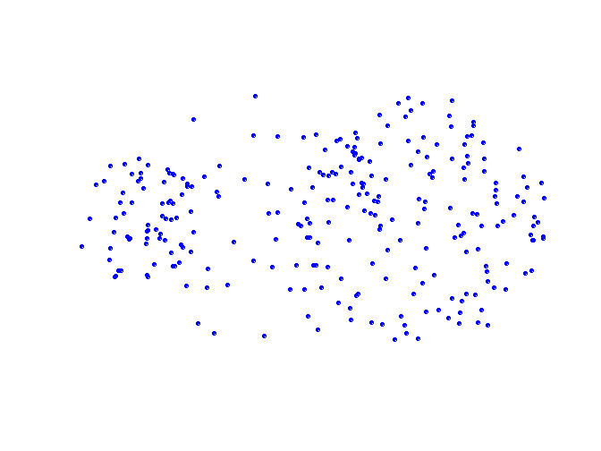
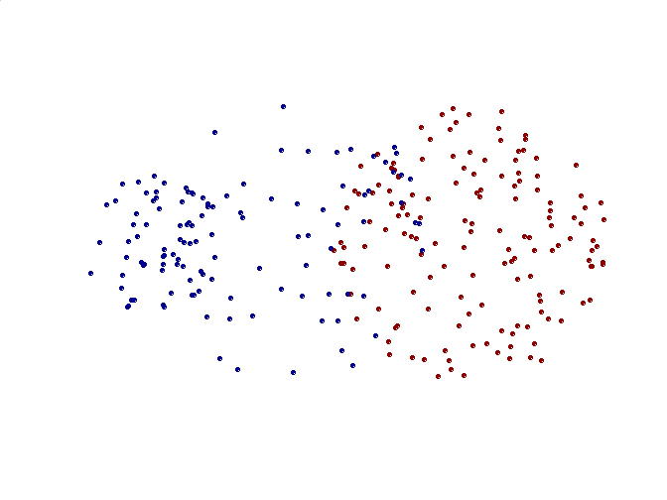
Limitations of single-link clustering
MACHINE INTELLIGENCE
Summary
Original Points
Two Clusters
Sensitive to noise and outliers
It produces long, elongated clusters

Slide 60
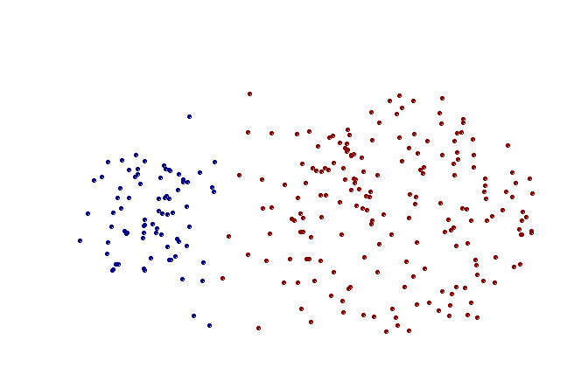
Strengths of complete-link clustering
MACHINE INTELLIGENCE
Summary
Original Points
Two Clusters
More balanced clusters (with equal diameter)
Less susceptible to noise

Slide 61
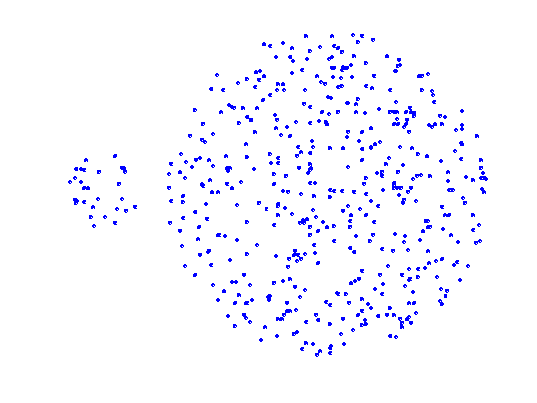
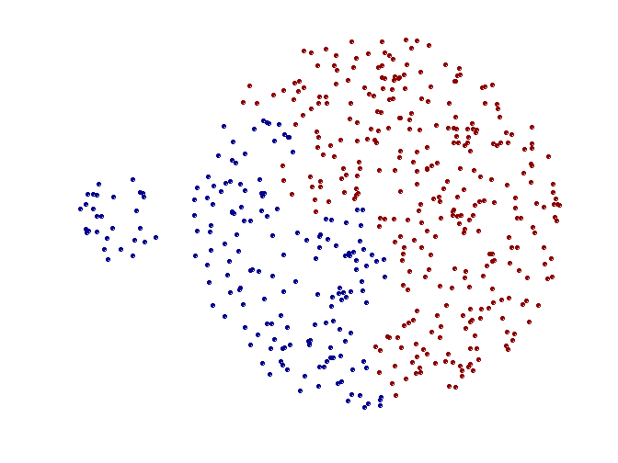
Limitations of complete-link clustering
MACHINE INTELLIGENCE
Summary
Original Points
Two Clusters
Tends to break large clusters
All clusters tend to have the same diameter – small clusters are merged with larger ones

Slide 62
Average-link clustering: discussion
MACHINE INTELLIGENCE
Summary
Compromise between Single and Complete Link
Strengths
Less susceptible to noise and outliers
Limitations
Biased towards globular clusters

Slide 63
Requirements for Clustering
MACHINE INTELLIGENCE
Summary
Ability to deal with different types of attributes
Discovery of clusters with arbitrary shape
Minimal domain knowledge required to determine input parameters
Ability to deal with noise and outliers
Insensitivity to order of input records
Robustness wrt high dimensionality
Incorporation of user-specified constraints
Interpretability and usability
Scalability

Slide 64
CHARACTERISTICS OF THE DATA THAT ARE IMPORTANT FOR CLUSTERING
MACHINE INTELLIGENCE
Summary
Attribute Type
Dimensionality
Noise and Outliers
Sparseness
Type of Proximity or density measure

Slide 65
MACHINE INTELLIGENCE
Resources
http://www2.ift.ulaval.ca/~chaib/IFT-4102-7025/public_html/Fichiers/Machine_Learning_in_Action.pdf
http://wwwusers.cs.umn.edu/~kumar/dmbook/.
ftp://ftp.aw.com/cseng/authors/tan
http://web.ccsu.edu/datamining/resources.html

Slide 66
THANK YOU
Dr. N MEHALA
Department of Computer Science and Engineering
mehala@pes.edu

